Slide 1
Introduction of OpenChain

Slide 2

What is ?

Slide 3
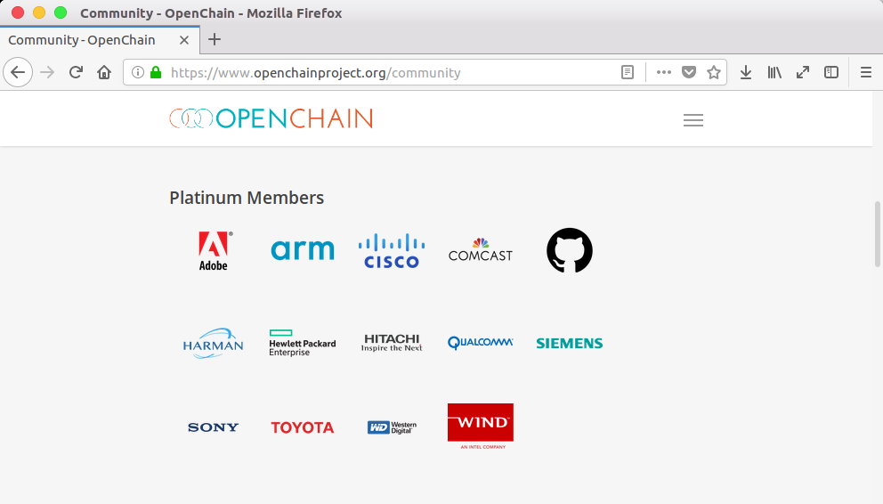
OpenChain is …
OpenChain is a project under the Linux Foundation, was founded in 2013 led by Qualcomm.
The purpose is to spread OSS compliance for the software supply chain and to standardize it.
Intellectual property department and OSS support department participate from member companies.
https://www.openchainproject.org/

Slide 4
Recent activities (Global)
For Spec 2.0
Consistency with ISO(International Organization for Standardization)
Multilingualization
Simplified Chinese, Traditional Chinese, French, German, Japanese, Korean, Portuguese, Spanish (Done)
Polish (translating on GitHub)
Russian, Hindi (working)
Italian (progress is unknown……)

Slide 5
Recent activities (Japan)
Japan Working Group
June @Toyota Nagoya
43 people participated (the highest number ever).
There were many first participants from Toyota group.
August @Fujitsu Kawasaki
The Toyota group member continue to participate despite holding in Kawasaki, 59 people participated (the highest number ever).
Making deliverables (Not just information sharing)
Improve efficiency of license and copyright detection
Create leaflets to spread our activity to suppliers
Translation of SPDX into Japanese
etc ……

Slide 6
